Slide 1
Python/GalSim Image Simulator
Progress Report
April 29, 2015
Aaron Bunch
NASA/JPL

Slide 2
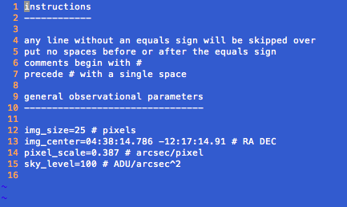
Observational Parameters Text File

Slide 3

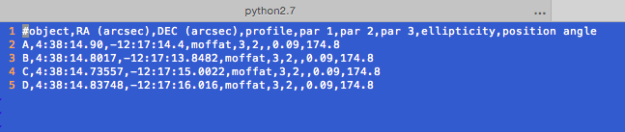
Object Parameters CSV Files
Reference Objects
Variable Flux Objects

Slide 4
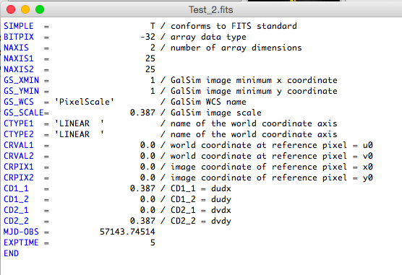
FITS Header

Slide 5
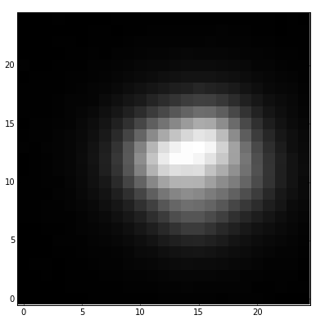
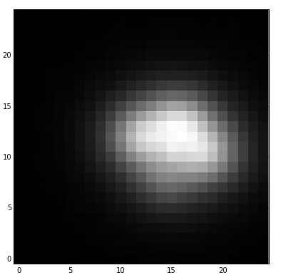
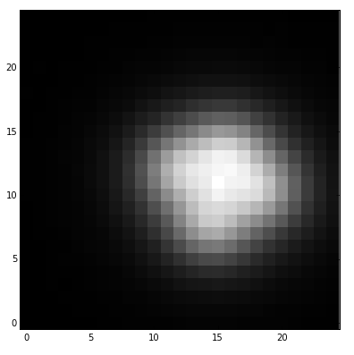
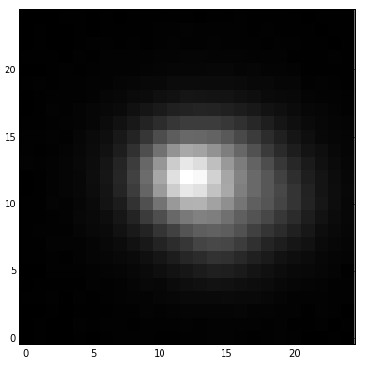
FITS Output

Slide 6
To Do:
Add more object profiles and parameters
Sersic profile, etc.
Integrate light curve simulations

